Slide 1

Support for Student Carers
Carolyn Johnstone
Nichola Kentzer
Rob Moore

Slide 2
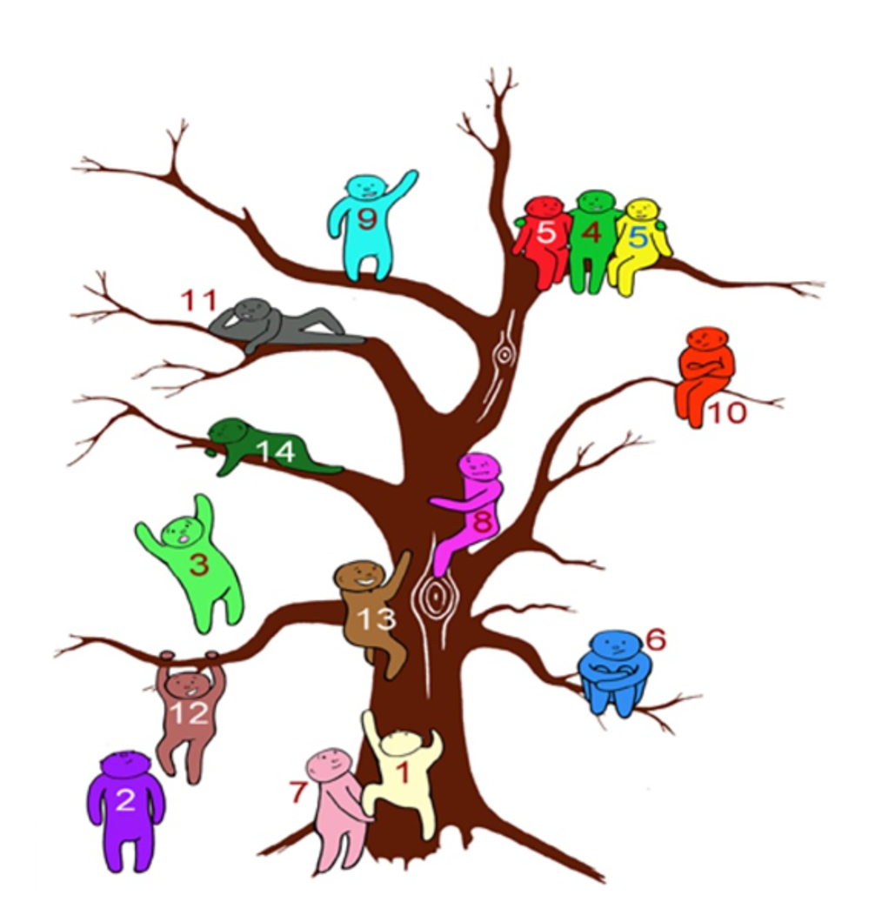
How are you doing?

Slide 3
What is a carer?
Anyone who cares, unpaid, for a friend or family member due to illness, disability, a mental health problem or an addiction.
5.8 million carers in the UK – State of Caring 2025
11.9 carers in UK – Carers week 2025
@170,000 young carers
12000 people become a carer every day
13% of Open University student population are known to be carers
Notes:
You may be a carer if you:
Help with personal care (washing, dressing, eating)
Provide emotional support or supervision
Manage medications or medical appointments
Assist with household tasks, shopping, or bills
Support someone with their mobility
Key points:
You don't need to live with the person you care for
You don't need to be caring for a certain number of hours
Young carers (under 18) also have legal rights
Many carers don't recognise themselves as such

Slide 4


Slide 5

Carer Flag – what does this mean?
Makes Tutor aware of your carer status
Can make adjustments to support you
You can update this anytime
Tutor support includes:
TMA extensions
Study planning
Individual support session
Access to tutorial recordings and flexible learning options.
Help Centre video
Notes:
You may be a carer if you:
Help with personal care (washing, dressing, eating)
Provide emotional support or supervision
Manage medications or medical appointments
Assist with household tasks, shopping, or bills
Support someone with their mobility
Key points:
You don't need to live with the person you care for
You don't need to be caring for a certain number of hours
Young carers (under 18) also have legal rights
Many carers don't recognise themselves as such

Slide 6
Student carer policy
Guidance on:
Special Circumstances
Deferrals
Study breaks
Reasonable adjustments
Exam adjustments available where needed
Financial support and fee credits may be available
Wellbeing and mental health support available.
Careers support tailored to carers.
Research students can access additional support through supervisors and the Graduate School.
Notes:
You may be a carer if you:
Help with personal care (washing, dressing, eating)
Provide emotional support or supervision
Manage medications or medical appointments
Assist with household tasks, shopping, or bills
Support someone with their mobility
Key points:
You don't need to live with the person you care for
You don't need to be caring for a certain number of hours
Young carers (under 18) also have legal rights
Many carers don't recognise themselves as such

Slide 7
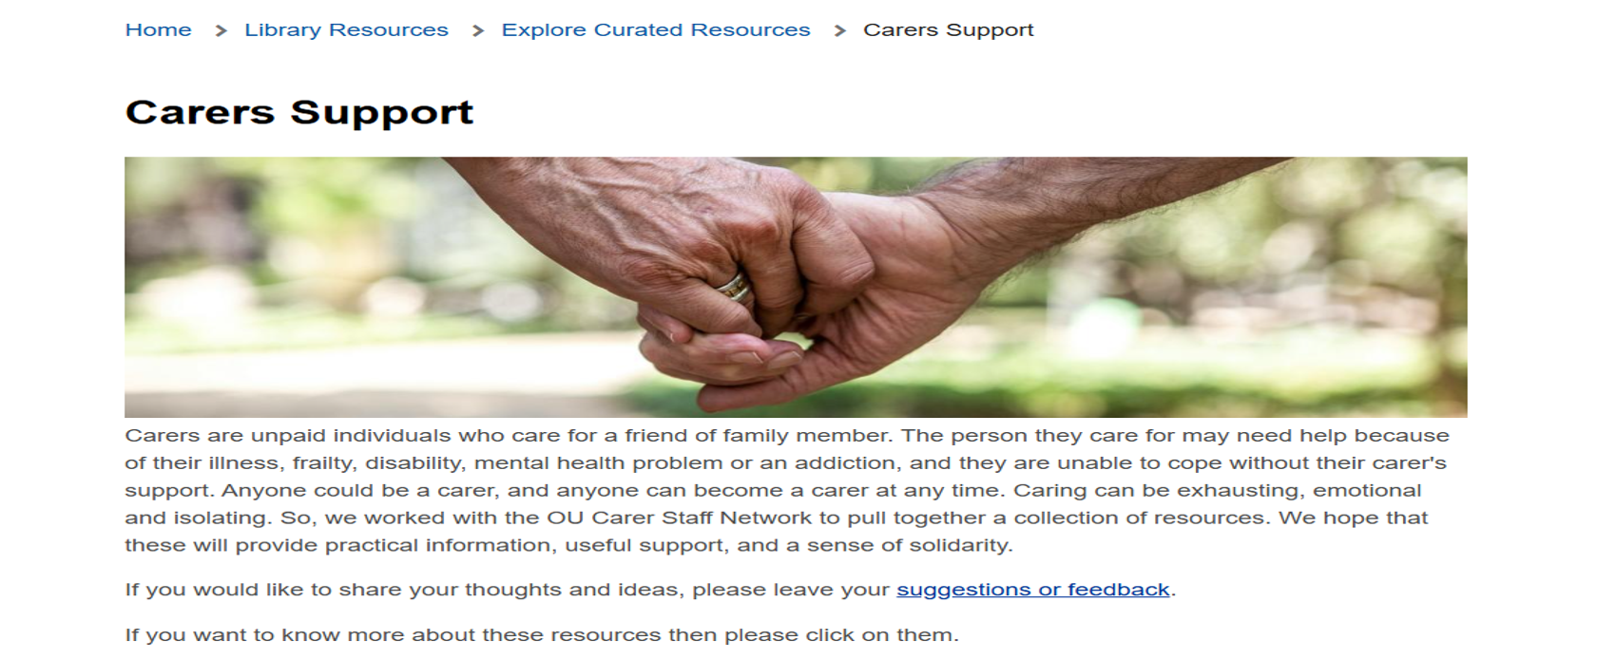
Library Carer Support
https://university.open.ac.uk/library/library-resources/carers-support
Notes:
You may be a carer if you:
Help with personal care (washing, dressing, eating)
Provide emotional support or supervision
Manage medications or medical appointments
Assist with household tasks, shopping, or bills
Support someone with their mobility
Key points:
You don't need to live with the person you care for
You don't need to be caring for a certain number of hours
Young carers (under 18) also have legal rights
Many carers don't recognise themselves as such

Slide 8

Open SU Carer Support Hub
https://www.oustudents.com/support-and-advice/carer-support/
Notes:
You may be a carer if you:
Help with personal care (washing, dressing, eating)
Provide emotional support or supervision
Manage medications or medical appointments
Assist with household tasks, shopping, or bills
Support someone with their mobility
Key points:
You don't need to live with the person you care for
You don't need to be caring for a certain number of hours
Young carers (under 18) also have legal rights
Many carers don't recognise themselves as such

Slide 9

Studying While Caring
Notes:
You may be a carer if you:
Help with personal care (washing, dressing, eating)
Provide emotional support or supervision
Manage medications or medical appointments
Assist with household tasks, shopping, or bills
Support someone with their mobility
Key points:
You don't need to live with the person you care for
You don't need to be caring for a certain number of hours
Young carers (under 18) also have legal rights
Many carers don't recognise themselves as such

Slide 10
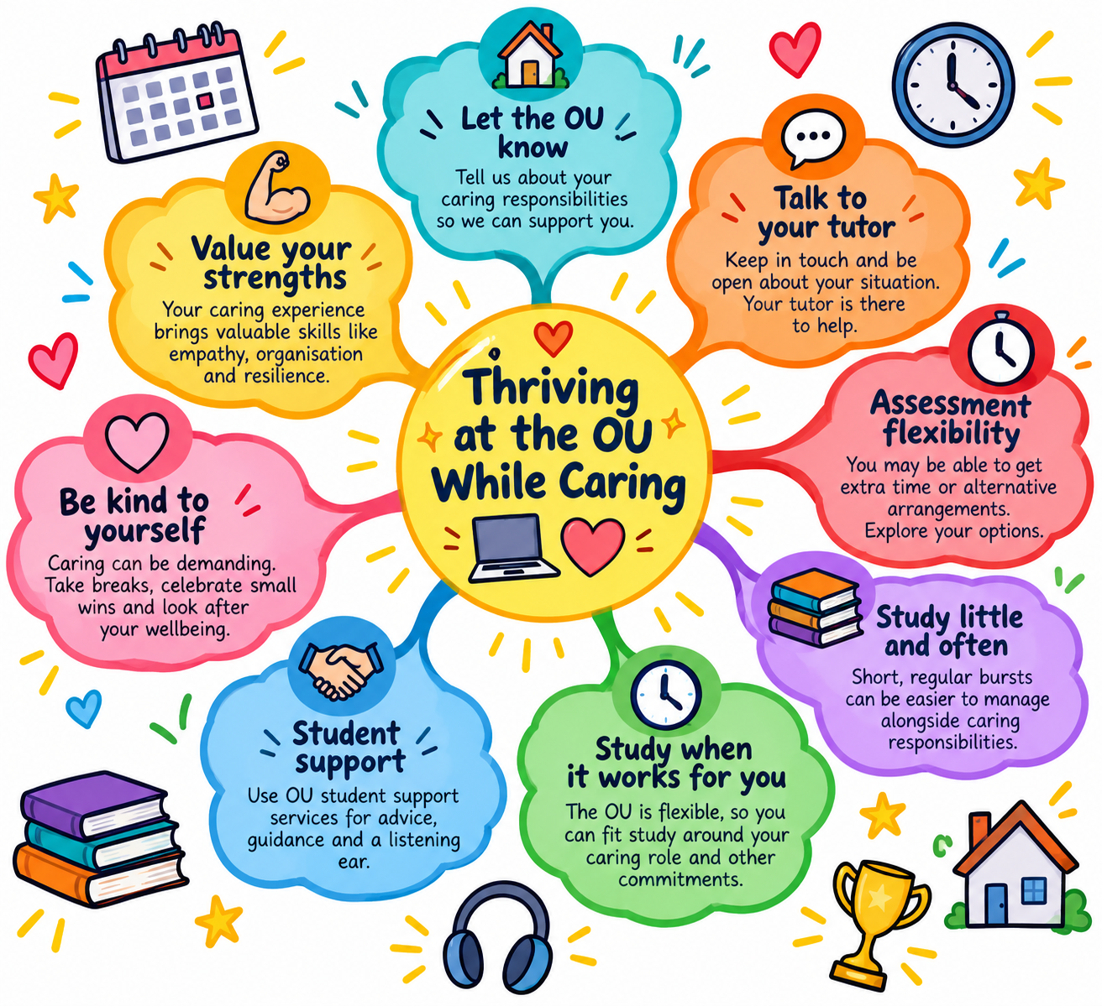

Slide 11




Taking a break
Caring for someone can be relentless and exhausting so breaks are vital for your own wellbeing and quality of life.​
​
After a break, many people feel recharged and rejuvenated and with a more positive outlook, it is easier to cope with challenging circumstances. ​
​
The person, or those, you care for could also benefit from enjoying new experiences, a change of scene and routine, and meeting other people.​
Breaks from caring/carer breaks - breaks-factsheet_2024-25.pdf
Carers' breaks and respite care - Social care and support guide - NHS
Carer Breaks & Respite for Carers | Carers Trust

Slide 12
Are you getting the support you need?
Carer’s Assessment: Right to a free assessment to identify support needs.
Support from Social Services
Carer’s Allowance/Carer Support Payment
Unpaid leave for emergencies (UK-wide).
1 week of unpaid carer’s leave per year (UK, phased in since 2024).
Right to request flexible working arrangements.
Protection from Discrimination: Caring responsibilities are protected under the Equality Act 2010.
Young carers have rights to school support.
Adult carers may access free or subsidised training.
Local Support from Carer Centre/Organisations
Social Work Department
Notes:
You may be a carer if you:
Help with personal care (washing, dressing, eating)
Provide emotional support or supervision
Manage medications or medical appointments
Assist with household tasks, shopping, or bills
Support someone with their mobility
Key points:
You don't need to live with the person you care for
You don't need to be caring for a certain number of hours
Young carers (under 18) also have legal rights
Many carers don't recognise themselves as such

Slide 13
Carer Allowance/Carer Support Payment
Scotland Carer Support Payment - mygov.scot | England and Wales Carer's Allowance: How it works - GOV.UK | NI Carer's Allowance | nidirect
Carer Support Payment Bi-annual Carer Supplement | Carer Allowance | Carer Allowance
35 hours per week or more | 35 hours per week or more | 35 hours per week or more
Earn less than £204 week | Earn less than £204 week | Earn less than £204 week
Part time: 21 hours a week in class or doing coursework. Full time 16-19 – at college/ university Aged 20 or older: any course. | Studying less than 21 hours per week | Studying less than 21 hours per week
£86.45 per week Scottish Carer Supplement (£11.70 per week) | £86.45 per week | £86.45 per week
OU 60 Credit module – 18 hours per week

Slide 14
Are you getting the support you need?
Carer’s Assessment: Right to a free assessment to identify support needs (adult support plan Scotland)
Support from Social Services
Carer’s Allowance/Carer Support Payment
Unpaid leave for emergencies (UK-wide).
1 week of unpaid carer’s leave per year (UK, phased in since 2024).
Right to request flexible working arrangements.
Protection from Discrimination: Caring responsibilities are protected under the Equality Act 2010.
Young carers have rights to school support.
Adult carers may access free or subsidised training.
Local Support from Carer Centre/Organisations
Social Work Department
Notes:
You may be a carer if you:
Help with personal care (washing, dressing, eating)
Provide emotional support or supervision
Manage medications or medical appointments
Assist with household tasks, shopping, or bills
Support someone with their mobility
Key points:
You don't need to live with the person you care for
You don't need to be caring for a certain number of hours
Young carers (under 18) also have legal rights
Many carers don't recognise themselves as such

Slide 15
Regular carer community support sessions throughout the year....​
Notes:
You may be a carer if you:
Help with personal care (washing, dressing, eating)
Provide emotional support or supervision
Manage medications or medical appointments
Assist with household tasks, shopping, or bills
Support someone with their mobility
Key points:
You don't need to live with the person you care for
You don't need to be caring for a certain number of hours
Young carers (under 18) also have legal rights
Many carers don't recognise themselves as such

Slide 16
Date | Time | Duration (mins) | Title
Tuesday 29th September 2026 | 11am | 90 | Support and Wellbeing for Student Carers: Start as you mean to go on (Welcome week) Teams
Wednesday 29th October 2026 | 11am | 90 | Support and Wellbeing for Student Carers: Halloween
Tuesday 17th November 2026 | 11am | 90 | Support and Wellbeing for Student Carers: Carers Rights Day
Wednesday 16th December 2026 | 11am | 90 | Support and Wellbeing for Student Carers: Festive Fun
Tuesday 12th January 2027 | 11am | 90 | Support and Wellbeing for Student Carers: January Boost
Wednesday 10th February 2027 | 11am | 90 | Support and Wellbeing for Student Carers: A Valentine for Carers
Wednesday 10th March 2027 | 11am | 90 | Support and Wellbeing for Student Carers: Optimising Study Success
Tuesday 13th April 2027 | 1830 | 90 | Support and Wellbeing for Student Carers:
Tuesday 18th May 2027 | 11am | 90 | Support and Wellbeing for Student Carers:
Wednesday 9th June 2027 | 11am | 90 | Support and Wellbeing for Student Carers: Celebrating Carers Week

